Slide 1
Introduction to RNA-Seq
Presenter| Philippe Moncuquet, CSIRO
12-14 July 2015

Slide 2
RNA-Seq

Slide 3

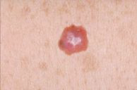



RNA-Seq
Koala
Melanoma
Wheat
Soil Biota
Corals
Ramaciotti Center for Genomics
RNA Extracted
Quantification
Comparison between conditions

Slide 4
RNA-Seq advantages
Dynamic gene expression captured in a snapshot (up or down-regulation in a particular condition/s)
Information about alternative splicing – which isoforms are being used
Can detect lowly expressed to very highly expressed genes (large dynamic range)
Prior knowledge not necessary – can predict novel transcripts

Slide 5
RNA-Seq experiment
Experimental design
Library preparation
Sequencing
Bioinformatic analysis
Validation

Slide 6
RNA-Seq experiment
Experimental design
Library preparation
Sequencing
Bioinformatic analysis
Validation

Slide 7
Experimental design
The experimenter is often interested in the effect of some process or intervention (the "treatment") on some objects (the "experimental units").
For differential expression analyses, researchers are interested in comparisons across treatment groups in the form of contrasts or pairwise comparisons.
In the absence of a proper design, it is impossible to partition biological variation from technical variation
No amount of statistical sophistication can separate confounded factors AFTER data have been collected
A correctly designed experiment implies to deal with :
Randomization – Replication – Blocking

Slide 8
Experimental design
Randomization
It is the process of assigning individuals at random to groups or to different groups in an experiment.
This reduces bias by equalising so-called factors (independent variables) that have not been accounted for in the experimental design.
Replication
Measurements are usually subject to variation and uncertainty.
Then, measurements are repeated and full experiments are replicated to help identify the sources of variation, to better estimate the true effects of treatments, to further strengthen the experiment's reliability and validity.
Blocking
Experimental units are grouped into homogeneous clusters in an attempt to improve the comparison of treatments by randomly allocating the treatments within each cluster or 'block'.
Blocking reduces known but irrelevant sources of variation between units and thus allows greater precision in the estimation of the source of variation under study.
Notes:
Randomization
A PhD student wants to study the effect of Oct4 gain of function (gof) on human cells.
Some cells line will integrate a construct for Oct4 gof (treatment) and some will not (control). Here Randomization is applied when randomly choosing which petri dish will receive the construct or not.
Replication
A PhD student wants to study the effect of Oct4 gain of function (gof) on human cells.
To avoid measurements uncertainty, each condition will contain 3 replicates :
3 petri dish with Oct4 gof (treatment)
3 petri dish without Oct4 gof (control)
Blocking
A PhD student wants to study the effect of Oct4 gain of function (gof) on human cells.
Blocking will be achieve by using cells from the same cell line and at the same stage of growth

Slide 9
Experimental design
If the treatment effects are not separable from possible confounding factors, then for any given gene, there is no way of knowing whether the observed difference in abundance between treatment groups is due to biology or to the technology.
Two main sources of variation that may contribute to confounding effects:
- Batch effects: errors that occur after random fragmentation of the RNA until it is input to the flow cell (PCR, reverse transcription).
- Lane effects: errors that occur from the flow cell until obtaining the data from the sequencing machine (bad sequencing cycles, base-calling)

Slide 10
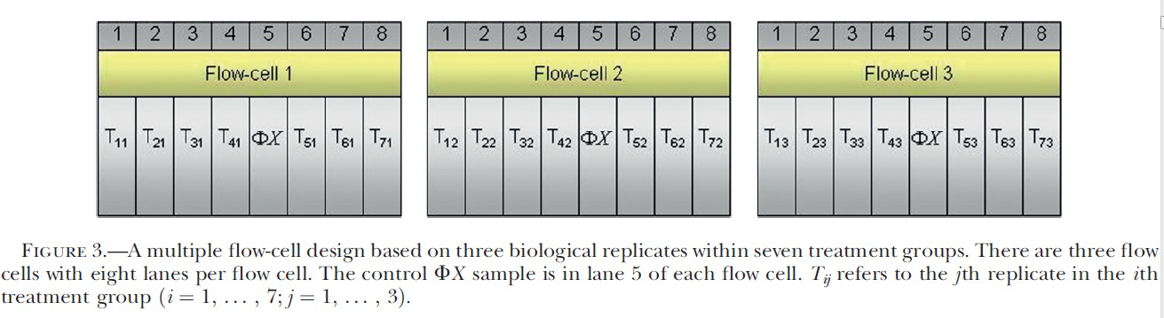
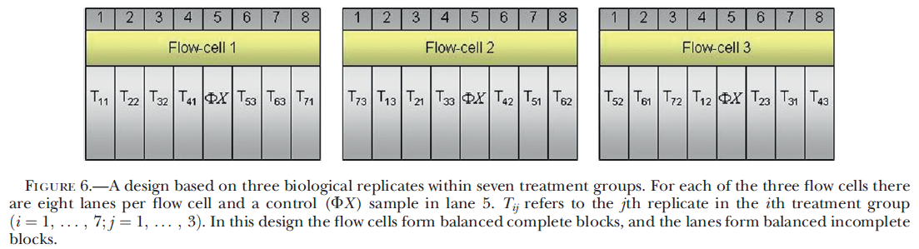
Experimental design
Any differences in expression between T1 and T2 are confounded with possible lane effects that may persist across flow cells.
Here flow cells form balanced complete blocks but lane effect can still cause some variability.

Slide 11
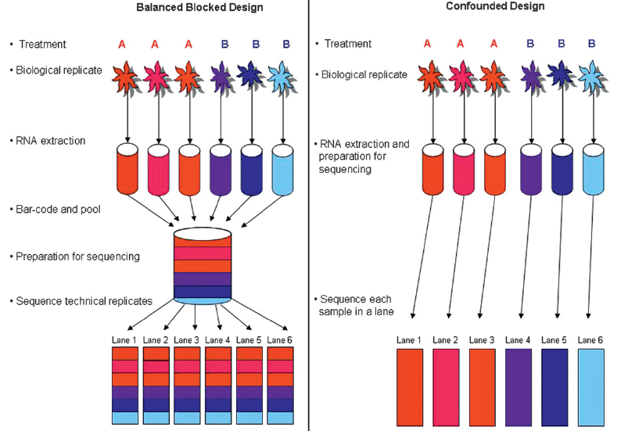
Experimental design
Multiplexing

Slide 12
Replicates vs Depth
Sufficient replicates important
How many depends on experiment being undertaken
Per-condition variance
Degree of difference between conditions
For DE gene expression: perhaps 20 M reads per sample and 3 – 10s replicates
For lowly expressed transcripts such as ncRNA greater read depth
Notes:
For researchers with a fixed budget, often a critical design question is wether to increase the sequencing depth at the cost of reduced sample numbers or to increase the sample size with limited coverage for each sample.
Necessary coverage is determined by the type of study, gene expression level, size of reference genome, published literature, and best practice defined by the scientific community
C = LN / G
C : coverage
L : read length
N : number of read
G : haploid genome length

Slide 13
RNA-Seq experiment
Experimental design
Library preparation
Sequencing
Bioinformatic analysis
Validation

Slide 14
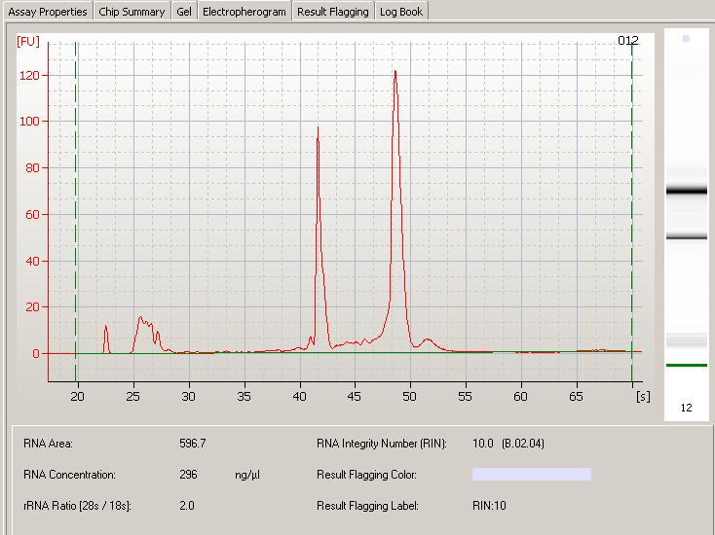
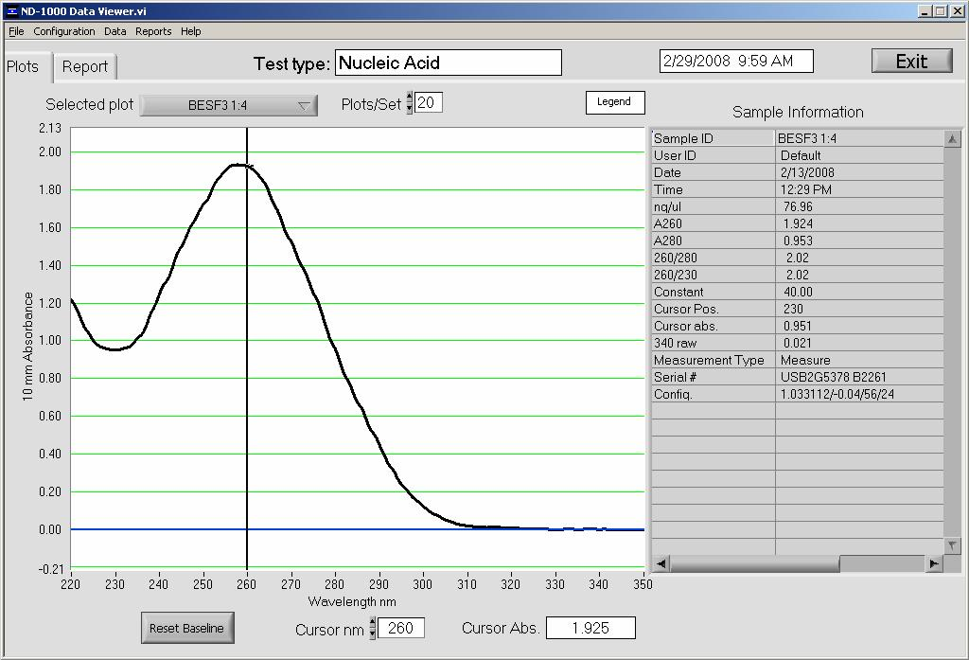
Library preparation
28S rRNA
18S rRNA
Extraction of total RNA
Tissue preparation – shearing, freezing etc. may result in degradation – need quality and quantity check
Quality: Bioanalyzer 28S/18S ~ 2 (RIN > 7 recommended)
Quantity: NanoDrop spectrophotometer -Concentration and Purity of RNA (100 – 250 ng)
Advice from sequencing facility
5S
region
marker
Bioanalyzer electropherogram
NanoDrop
Notes:
Electropherogram – x axis time (s), y-axis fluorescence. 2 ribosomal peaks 18S and 28S rRNA. rRNA > 90% total RNA
5S/tRNA – 5-15% RNA in eukaryotic cells
If microRNA want to make sure appropriate RNA isolation procedure which does not remove these small RNAs
Bioanalyzer RIN algoithm takes account of whole elctropherogram
Assumption that integrity of rRNA gives good indication of integrity of mRNA (or the RNA you’re interested in)
rRNA half life (4-5 days) other RNA may be less
UV absorption using a spectrophotometer. In its simplest form the absorbance is measured at 260 and 280 nm. The concentration of nucleic acid can be determined using the Beer-Lambert law, which predicts a linear change in absorbance with concentration.
RNA has its absorption maximum at 260 nm and the ratio of the absorbance at 260 and 280 nm is used to assess the RNA purity of an RNA preparation. Pure RNA has an A260/A280 of 2,1.
and a A260:A230 ratio of 1.8–2.3.
Low A260:A280 ratios indicate contamination with protein and low A260:A230 ratios
indicate contamination with reagents used in the extraction such as phenol or salt
RIN (RNA Integrity Number)
Quantity of RNA (500 ng – 13 cycles of PCR, 200 ng – 14 cycles PCR)

Slide 15
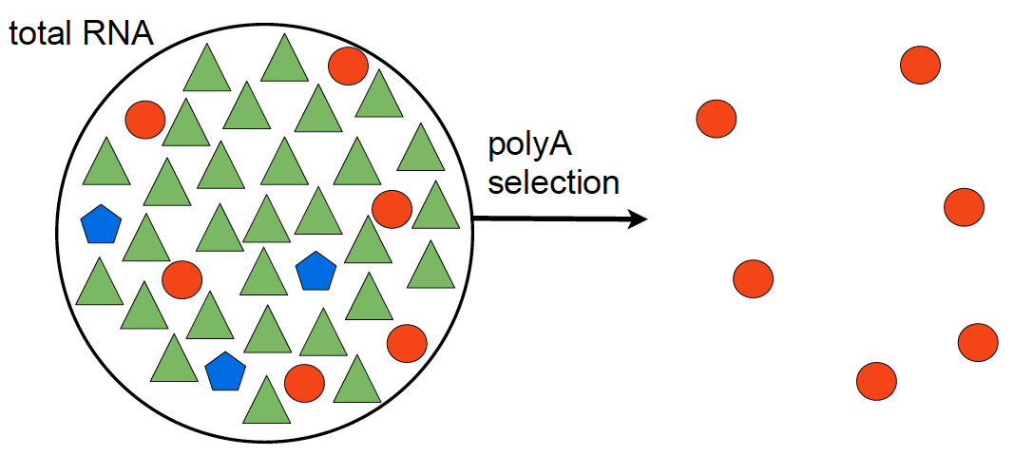
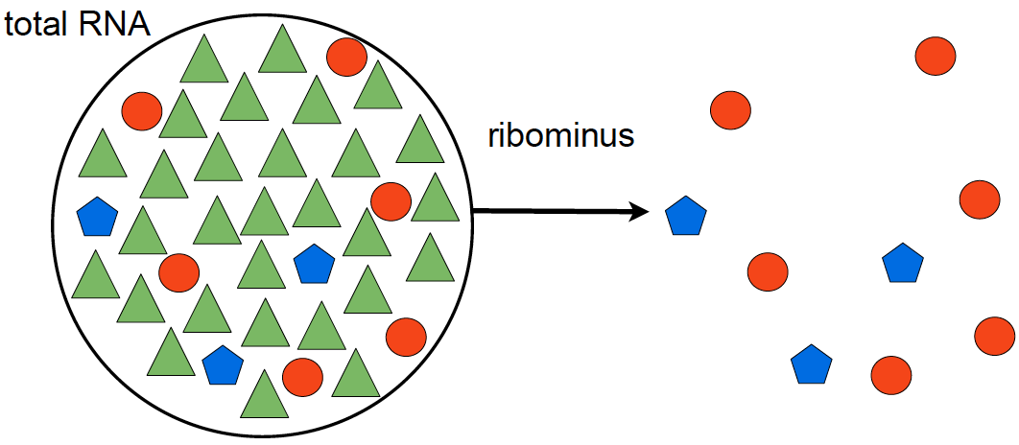
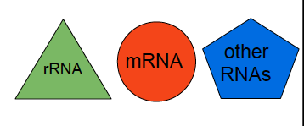
Library preparation
polyA selection
ribominus selection
poly(A+)-transcripts:
mRNAs,
some lncRNAs
immature microRNAs,
snoRNAs
non rRNA transcripts:
Non- coding RNAs
mRNAs,
Notes:
Ribominus deletes ~ 99.9 % ribosomal RNA
Ribominus need 2 – 10 ug total RNA
removal of ribosomal RNA (rRNA) using biotinylated, target-specific oligos combined with Ribo-Zero rRNA removal beads.

Slide 16
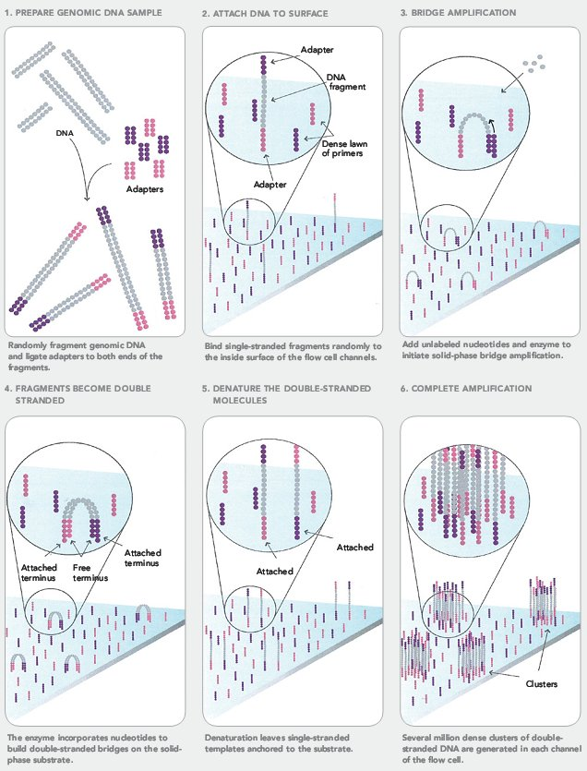
Library preparation
Removal of unwanted RNA
Fragmentation of RNA
Reverse transcription to cDNA
Conversion to ds cDNA
Ligation to 3’ and 5’ adapters
Fragments adhere to surface of flow cell
Fragments are amplified (cluster generation)
Illumina
Notes:
Following purification, the RNA is fragmented into small pieces using divalent cations under elevated temperature.
The cleaved RNA fragments are copied into first strand cDNA using reverse transcriptase and random primers, followed by second strand cDNA synthesis using DNA Polymerase I and RNase H.
These cDNA fragments then have the addition of a single 'A' base and subsequent ligation of the adapter.
Adapters = short oligos which allow (1) DNA fragment to bind to flow cell (2) PCR enrichment of bound fragments (3) allow for barcoding
TruSeq Universal Adapter:
5 AATGATACGGCGACCACCGAGATCTACACTCTTTCCCTACACGACGCTCTTCCGATCT 3
TruSeq Indexed Adapter
5 GATCGGAAGAGCACACGTCTGAACTCCAGTCAC‐NNNNNN‐ATCTCGTATGCCGTCTTCTGCTTG 3
Here “N” is any nucleotide, and the 6 of them together are a unique sequence which can readily be
identified as unique to 1 library.

Slide 17
RNA-Seq experiment
Experimental design
Library preparation
Sequencing
Bioinformatic analysis
Validation

Slide 18
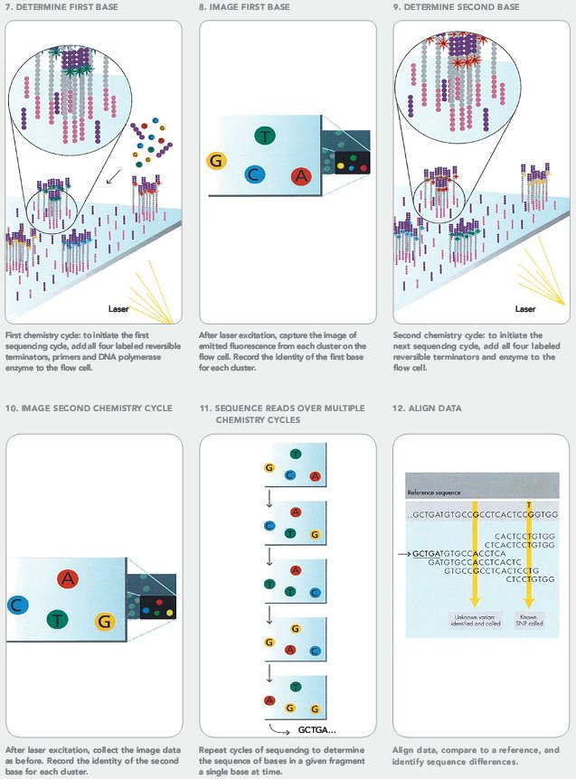
Sequencing
dNTPs introduced into the flow cell
Each dNTP fluorescently labelled with different dye
The 4 bases compete for binding to first base of the DNA template
Unbound dNTP washed off
Laser used to excite the dyes
Image captured
3’ terminal group and dye removed
Cycle repeated (# times = read length
Notes:
Sequencing occurs by introducing reagents (DNA nts, DNA polymerase into the cell). Adenine, cytosine, guanine, thymine each with a blocking group and each fluorescently labeled with a different colour. The 4 bases compete for binding on the DNA template. Unbound are washed away. After each synthesis a laser is used to excite the dyes and an image is taken. A chemical deblocking step removes the 3’ terminal blocking group and the dye. The process is then repeated for the number of times you want (read length).
Illumina libraries sequencing starts at end of adapter

Slide 19
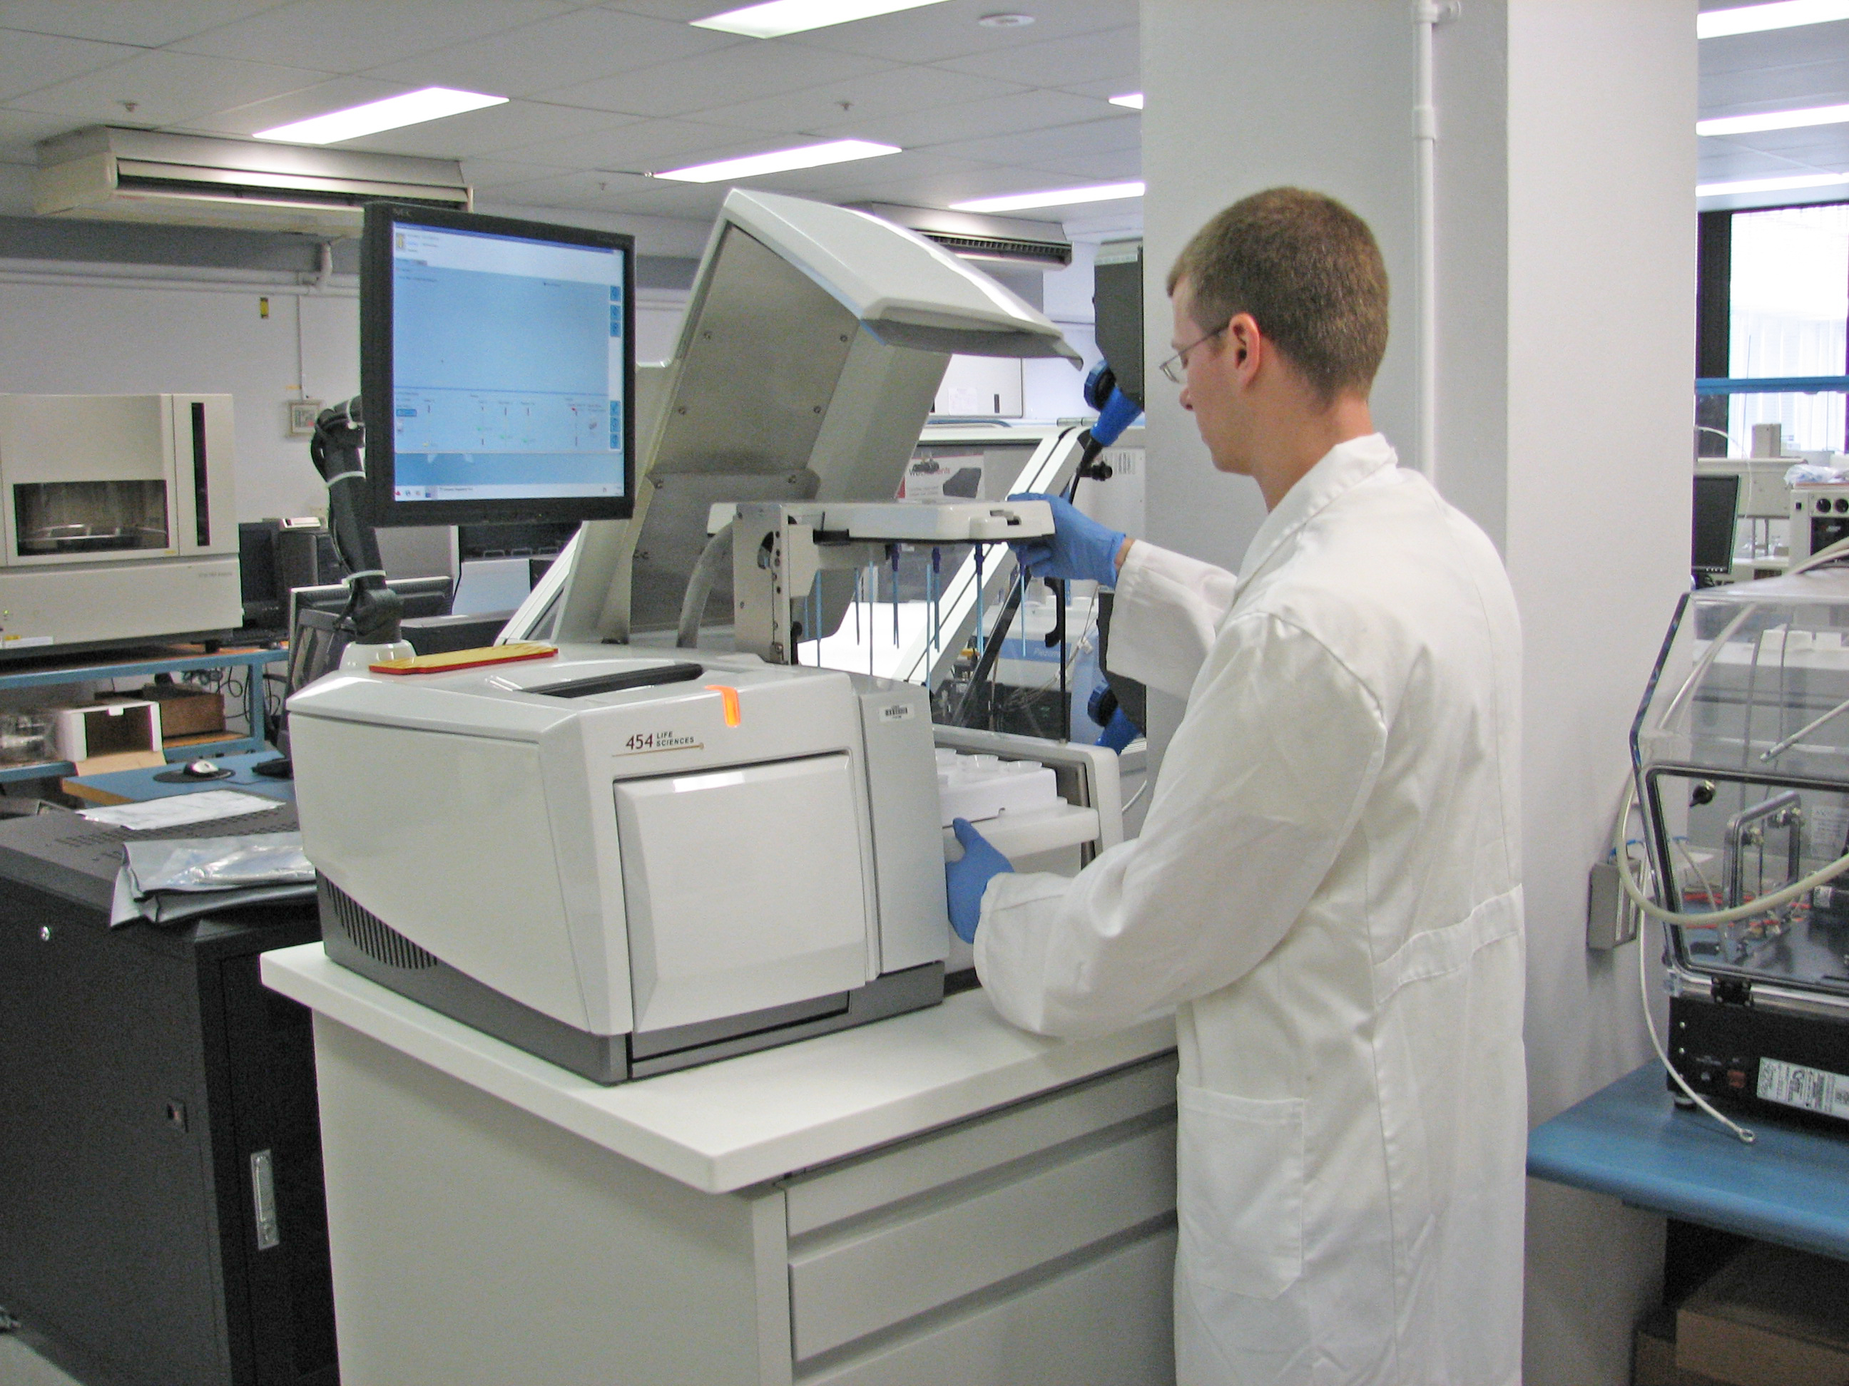
Sequencing
Fastq files

Slide 20
RNA-Seq experiment
Experimental design
Library preparation
Sequencing
Bioinformatic analysis
Validation

Slide 21
RNA-Seq experiment
Bioinformatic analysis
Quality checking
Mapping reads to genome
Read summarization
Differential expression
Biological interpretation

Slide 22
RNA-Seq experiment
Bioinformatic analysis
Quality checking
Mapping reads to genome
Read summarization
Differential expression
Biological interpretation

Slide 23
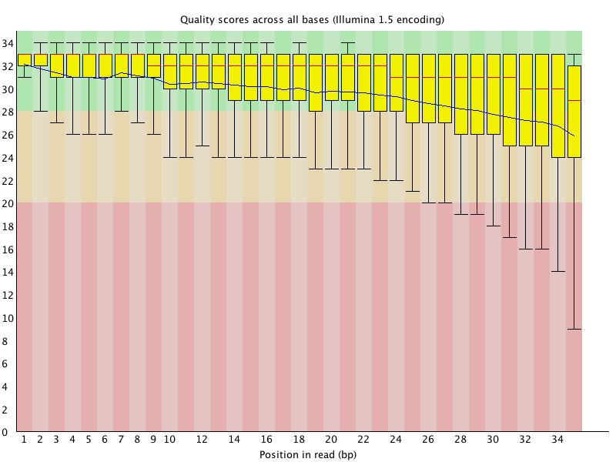
Quality checking
Covered yesterday
FastQC tool
Generally unnecessary to trim unless doing de novo assembly
Notes:
Trimming recommended if SNP calling but otherwise unnecessary
SeqPrep
Fastx trimmer
Seqtk trimmer
Simon Anders: The point of trimming low-quality base-calls is to remove bases which might be erroneous. A naive aligner would be deterred from a valid mapping by mismatches that are only due to sequencing errors. A quality-aware aligner, however, knows that a mismatch of a low-quality base is no reason to reject an otherwise good mapping and will report it. Many of the currently popular aligners work this way, i.e., they pay less attention to the low-quality ends of reads. By trimming, you basically take away from the aligner the chance to make use of this feature. However, trimming makes a hard-cut decision (everything below a quality threshold is removed) while a well-designed quality-aware aligner may make a more sophisticated, gradual, decision.
Bowtie takes quality scores into account

Slide 24
RNA-Seq experiment
Bioinformatic analysis
Quality checking
Mapping reads to genome
Read summarization
Differential expression
Biological interpretation

Slide 25
Alignment of reads to genome
mRNA processing/splicing
Gene A
T A1
T A2
Mapping RNA-seq reads back to genome
Gene A
?
?

Slide 26
Alignment of reads to genome
Must use a splice-aware aligner
Tophat2
GSNAP
MapSplice
PALMapper
ReadsMap
Star
Engstrom et al., Nature Methods (2013)
Notes:
Illumina 75 bp reads. Human leukemai cellline K562 (1.3 x10⁹ reads), mouse brain (1.1 x 10⁸ reads), 2 simulated human transcriptomes (8 x10⁷ reads each)
TopHat – low tolerance for mismatches – low base quality scores not mapped

Slide 27
Alignment of reads to genome
Tophat –solexa-quals –g 2 –library-type fr-unstranded –j annotation/Danio_rerio.Zv9.66.spliceSites –o tophat/SV9_6h genome/ZV data/6h_1.fastq data/6h_2.fastq
BAM/SAM file
Notes:
Tophat
Calls Bowtie. Bowtie determines which alignments are valid by (1) number of mismatches (default=2) in seed (first x bases on L of read, default=28) (2) sum of Phred quality scores for all mismatches must not exceed –e, default=70)

Slide 28
RNA-Seq experiment
Bioinformatic analysis
Quality checking
Mapping reads to genome
Read summarization
Differential expression
Biological interpretation

Slide 29
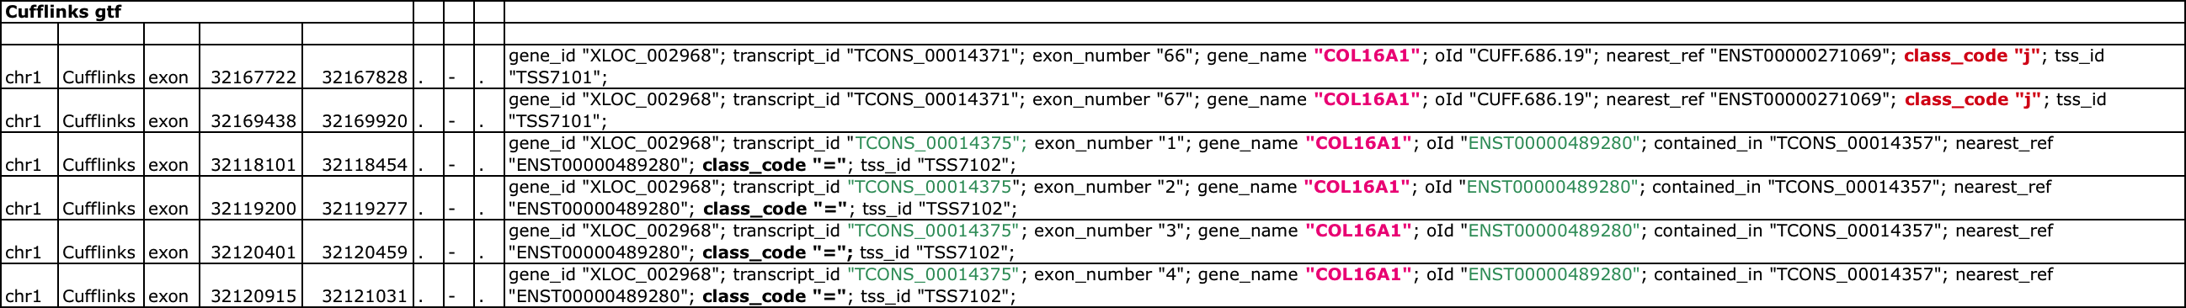
Read summarization -mapping reads to features– transcript assembly
BAM file
Genomic location of read
Genomic Features GFF /GTF files
Gene, non-coding RNA etc

Slide 30
Read summarization
Different tools available:
Cufflinks – FPKM values for transcripts
featureCounts (Counts)
Rsubread – Bioconductor package (Counts)
HTSeq-count (Counts)

Slide 31
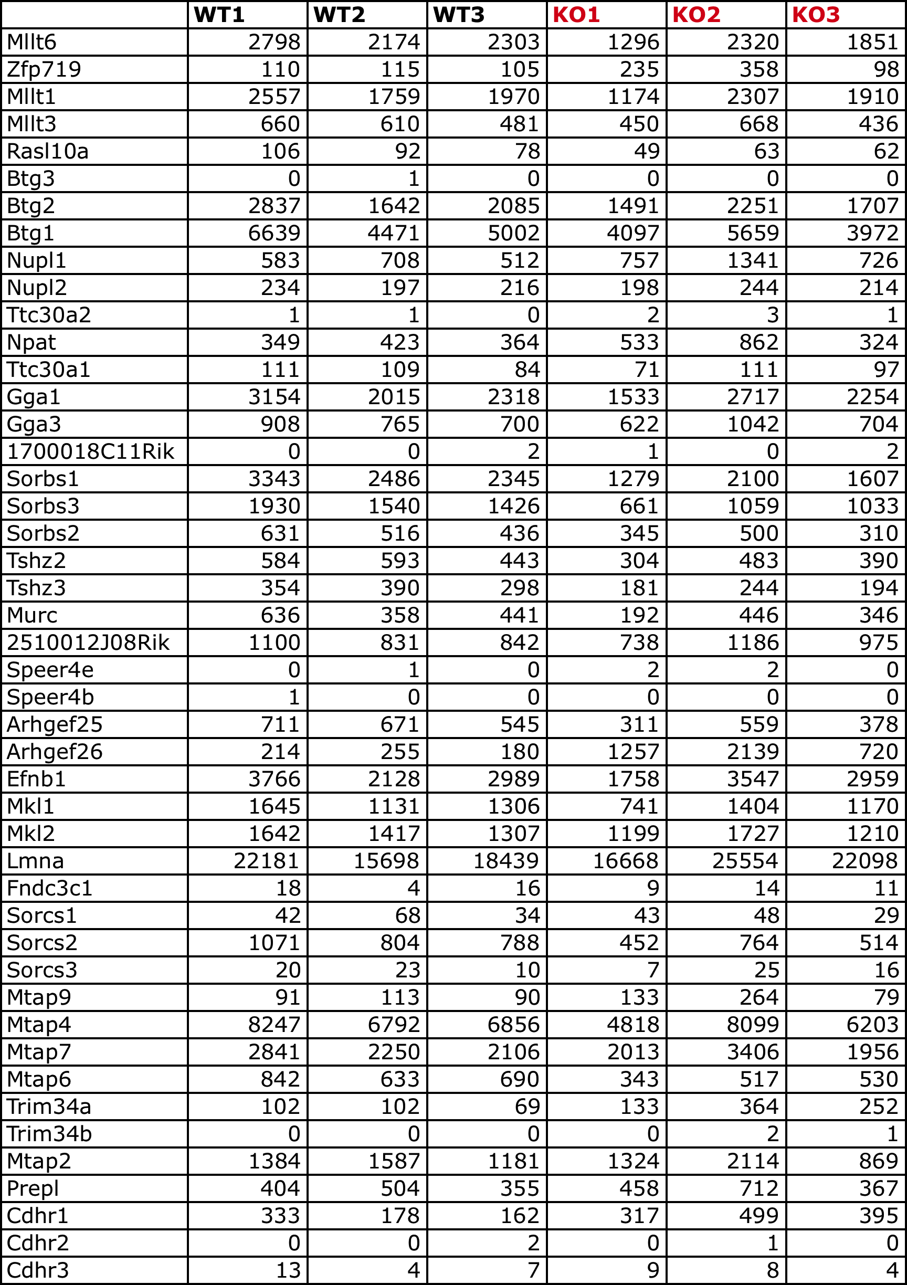
Read summarization
Feature count table
BAM file
+
GTF file
+
31

Slide 32
RNA-Seq experiment
Bioinformatic analysis
Quality checking
Mapping reads to genome
Read summarization
Differential expression
Biological interpretation

Slide 33
Differential expression analysis
Intensive effort to develop the best statistical approach. Challenging because:
Small number of replicates per condition
Large number of features being tested (> 20,000 genes)
Large range of counts (< 10 to 100,000s)
Different sequencing depth between samples
RNA-Seq -> Count data - Discrete not Continuous (contrast microarray)

Slide 34
General principles
Read count per gene is a random variable
Counts modeled as a distribution e.g. Negative Binomial Distribution
Parameters (mean and variance) estimated from the data
Null hypothesis – read count for controls and condition come from the same distribution
Statistical tests applied to see if Null hypothesis should be rejected (p value). Is the fold change significant.
Multiple testing adjustment (control false positive rate) –> Adjusted p-value < 0.1
Notes:
(gene expression is a stochastic process Elowitz et al. Science (2002))B
Bonferoni pi< alpha/number of tests
BH rank p values small to biggest order p value is < i/m alpha

Slide 35
Differential expression analysis tools
Direct count methods e.g. DESeq2, edgeR, Voom, baySeq, TSPM
Transcript based methods e.g. Cuffdiff

Slide 36
Differential expression analysis
Normalization
Differences in total reads per sample
Possibility that some reads highly over-represented
Calculation of dispersion for each gene (variation between samples)
Underestimation – false positives
Over-estimation – false negatives
Determining whether fold change between conditions is significant
Also possible to test with more than one condition using Generalized Linear Models (GLMs) e.g. edgeR and DESeq2

Slide 37
Differential expression analysis
 | Rep1 | Rep2 | Rep3
Gene A | 5 | 3 | 12
Gene B | 16 | 25 | 35
Gene C | 10 | 15 | 3
Gene D | 750 | 500 | 500
Gene E | 1504 | 1005 | 1030
Gene E has about twice as many reads aligned to it as Gene D. This could mean:
Gene E is expressed with twice as many transcripts as Gene D
Both genes are expressed with the same number of transcripts but Gene E is twice as long as Gene D and produces twice as many fragments
Both genes are the same length and expressed at the same level, but Gene D has a close paralog and some of its reads were lost due to non-unique alignment.
It is easier to compare a gene expression between conditions than comparing genes expression in the same condition
To cope with gene length variability, read counts are often reported as FPKM
FPKM stand for Fragments Per Kilobase of exon per Million fragments mapped

Slide 38
Differential expression analysis
Multiple testing
Multiple testing is frequent in RNASeq, most of the time you will run a statistical test over a large number of entity (genes, features...)
Testing 30 000 genes with a P value threshold set at 0.01 will produce 300 genes differentially expressed by random chance
To deal with this, there is different solution
- reporting the FDR along with the p-value to prove the relevance of your list
- lowering the threshold of the P value
- report corrected P value (Bonferroni, Holm, Hochberg...)

Slide 39
Differential expression analysis
It is entirely possible for two different, accurate statistical approaches to produce very different sets of differentially expressed genes from the same data set.
Gene sets called by DESeq and EdgeR methods can differ substantially because each approach is uses different assumptions to arrive at its (correct) result.
This discrepancy will be exacerbated when experiments are under-powered.
Vastly different gene sets from accurate statistical models may be indicative of an underpowered experiment.
Use several tools, compare their results to create a DE list in which you can be confident
Notes:
For example, if an experiment has a sufficient number of replicates to detect 100% of the genes that were differentially expressed, then all accurate statistical approaches would converge on a very similar list. If an experiment only has enough replicates to detect 20% of the genes that are differentially expressed then two different approaches may identify two very different sets of genes, depending on the particular biases of the approach.

Slide 40
RNA-Seq experiment
Bioinformatic analysis
Quality checking
Mapping reads to genome
Read summarization
Differential expression
Biological interpretation

Slide 41
Biological interpretation
Assumption [RNA] -> [protein]
Ideally other information should be incorporated e.g. proteomics, miRNA
We generally rely on database annotations
But annotations per “gene”
Isoforms may have different functions
Functions may differ in different tissues/cells
RNA-Seq takes a snapshot
but RNA is dynamic (expression, processing, degradation)
Genes/proteins operate in networks
What is the effect of change in expression in some genes in a pathway
compensation mechanisms/remodelling

Slide 42
Biological interpretation

Slide 43
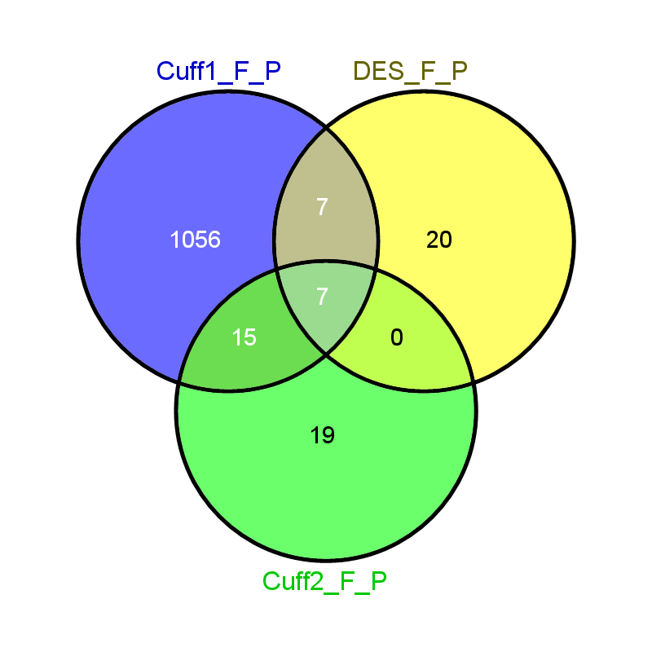


Evolution of tools
Important to report the version of software used.
An example from my experience
Frontal lobe vs Parietal lobe
Frontal lobe vs Temporal lobe
Cuffdiff (v 1.3.0), Cuffdiff2 (v 2.0.2), DESeq (v 1.10.1)
Notes:
Brain lobe experiment. Cuffdiff1 not taking account of within group variablility
Tophat – Cufflinks – Cuffdiff (1.3.0) pipeline for RNA-Seq

Slide 44
Performance of RNA-Seq
Notes:
Sequencing Quality Control Consortium is a continuation of Microarray Quality Control (MAQC) to assess performance and reproducability of next-gen sequencing of RNA and DNA.
close partnership with the Association of Biomolecular Resource Facilities (ABRF), an international organization of life sciences core facility laboratories and biotechnology research laboratories

Slide 45
RNA-Seq experiment
Experimental design
Library preparation
Sequencing
Bioinformatic analysis
Validation

Slide 46
Validation
Validation is necessary in order to publish
No gold standard
qPCR often used but not necessarily a gold standard (SEQC study)
Number of genes
Isoforms
Other possibilities
Microarray
Proteomics (Mass spec)
Comparative analysis with other published data sets

Slide 47
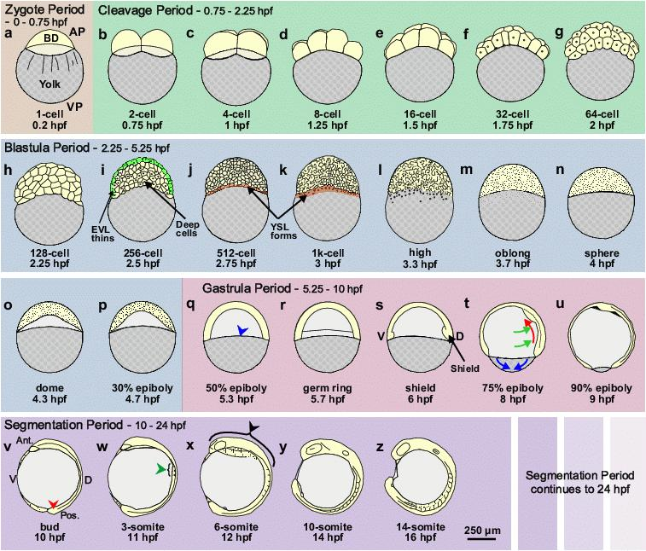
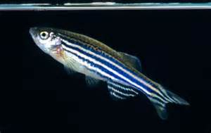
Today’s exercises
Toy data set (small subset): time and computer constraints
Compare development stages (2 cell vs 6 hrs)
Zebrafish (Danio rerio)

Slide 48
Between morning tea and lunch
You are given the fastq read file for the 6h sample
Use Tophat2 to map 6h sample to reference genome
We have already mapped the 2 cell data for you
While the mapping is proceeding (~ 20 minutes) look at the files we have already created for the 2 cell data
Then
Use Samtools to sort your bam file
View the sorted.bam with IGV
Zebrafish (Danio rerio)

Slide 49
Between lunch and afternoon tea
Use Cufflinks to assemble transcriptome from the zebra fish bam files (both 2 cell and 6 h bam files)
Output = ZV9_2cells_gtf and ZV9_6h_gtf
View with IGV and compare with gtf files we have already compiled for you
Use Cuffdiff to see which genes DE between the 2cell and 6h development stages
Zebrafish (Danio rerio)
Open R and use the package cummeRbund to visualise some of the DE results

Slide 50
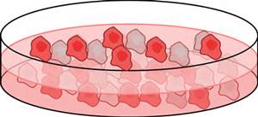
After afternoon tea
Case study in edgeR Users Guide (4.3)
Experiment by Li et al. 2008
LNCaP cells – androgen sensitive prostate cancer cell line
Inactive substance
DHT (androgen)

